Slide 1

Introduction to Computer Systems
Computer networks

Slide 2

Lecture 11 Design a Network

Slide 3
Lecture Outline
Design Considerations for a Small Network
Scale to a Large Network
Threats to the Network
Keeping the Network Safe

Slide 4

Design and Create a Small Network
Topologies
Device selection
IP addressing
Redundancy
Design considerations
Common applications
Common protocols
Real time applications
Scaling the small network
Protocol analysis

Slide 5
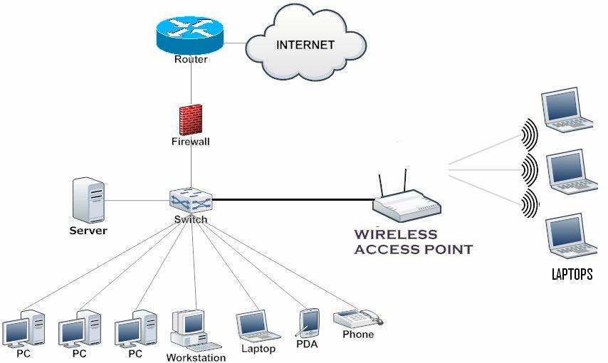
Topologies
Typical Small Network Topology

Slide 6
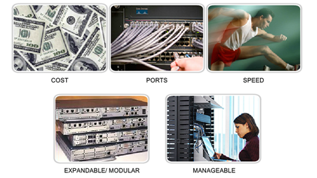
Device Selection
Factors to be considered when selecting intermediate devices.

Slide 7
IP Addressing
IP addressing scheme should be planned, documented and maintained based on the type of devices receiving the address.
Examples of devices that will be part of the IP design:
End devices for users
Servers and peripherals
Hosts that are accessible from the Internet
Intermediary devices

Slide 8
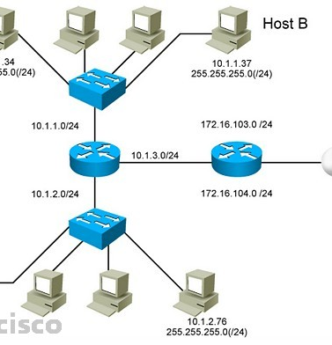
IP Addressing cont.
Planned IP schemes help the administrator:
Track devices and troubleshoot
Control access to resources

Slide 9
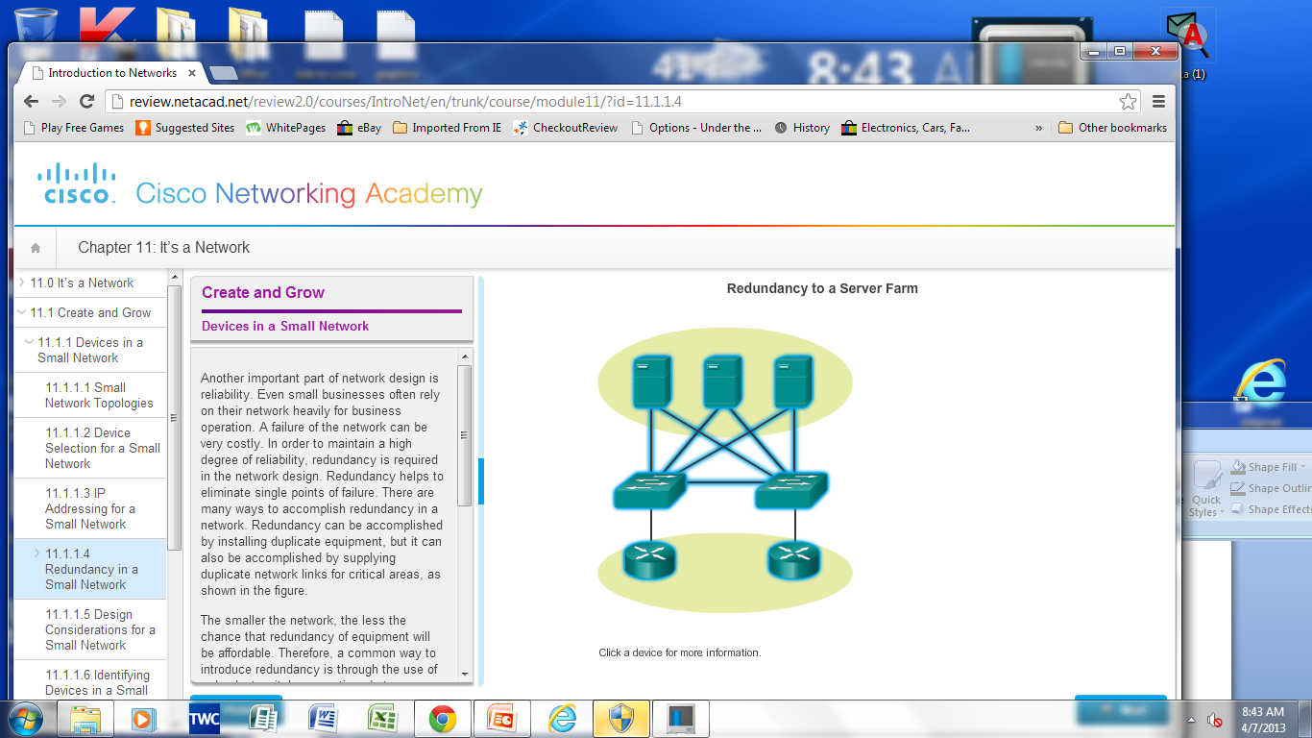
Redundancy
Redundancy helps to eliminate single points of failure.
Improves the reliability of the network.

Slide 10
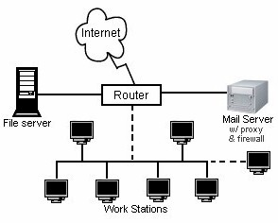
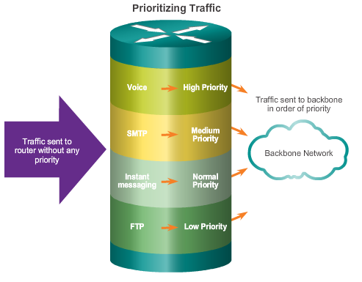
Design Considerations
The following should be included in the network design:
Secure file and mail servers in a centralized location.
Protect the location by physical and logical security measures.
Create redundancy in the server farm.

Slide 11
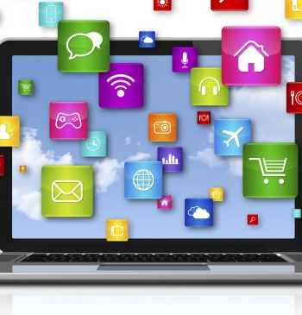
Common Applications
Network-Aware Applications
Software programs that are used to communicate over the network.
Application Layer Services
Programs that interface with the network and prepare the data for transfer.

Slide 12
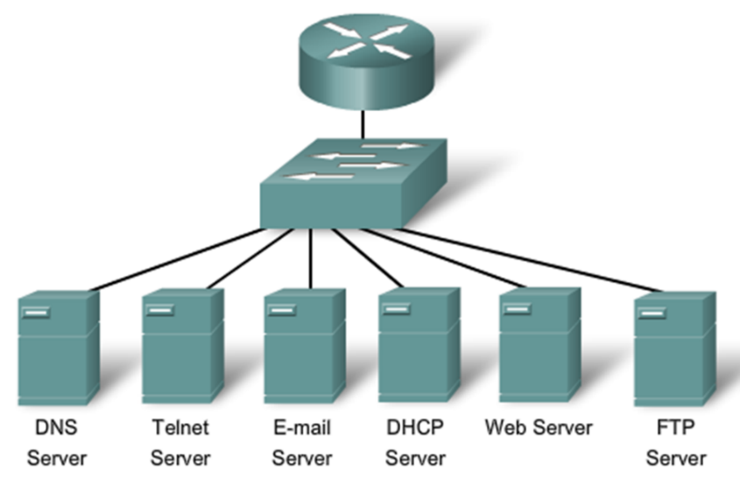
Common Protocols
Network Protocols Define:
Processes on either end of a communication session.
Types of messages.
Syntax of the messages.
Meaning of informational fields.
How messages are sent and the expected response.
Interaction with the next lower layer.
53 23 25 68 80/443 21

Slide 13


Real-Time Applications
Real-time applications require planning and dedicated services to ensure priority delivery of voice and video traffic.
Infrastructure – Needs to be evaluated to ensure it will support proposed real time applications.
VoIP – Is implemented in organizations that still use traditional telephones.
IP telephony – The IP phone itself performs voice-to-IP conversion.
Real-time Video Protocols – Use Time Transport Protocol (RTP) and Real-Time Transport Control Protocol (RTCP).

Slide 14
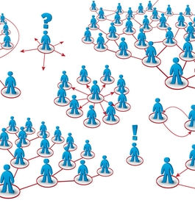
Scaling a Small Network
Important considerations when growing to a larger network:
Documentation –Physical and logical topology.
Device inventory – List of devices that use or comprise the network.
Budget – Itemized IT expense items, including the amount of money allocated to equipment purchase for that fiscal year.
Traffic Analysis – Protocols, applications, and services and their respective traffic requirements should be documented.

Slide 15
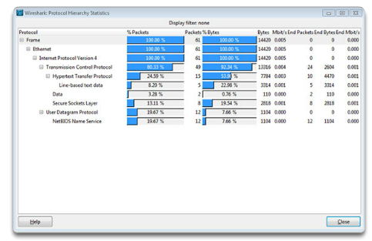
Protocol Analysis
Information gathered by protocol analysis can be used to make decisions on how to manage traffic more efficiently.

Slide 16
Keeping the Network Safe
Threats to Network Security
Physical Security
Security Vulnerabilities
Malware
Network Attacks
Mitigating Network Attacks

Slide 17
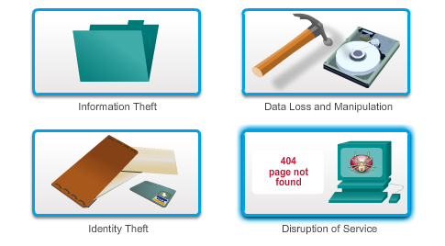
Threats to Network Security
Categories of Threats to Network Security

Slide 18
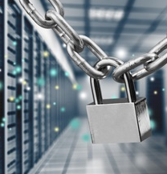
Physical Security
Four classes of physical threats are:
Hardware threats
Physical damage to servers, routers, switches, cabling plant, and workstations
Environmental threats
Temperature extremes (too hot or too cold)
humidity extremes (too wet or too dry)

Slide 19
Physical Security Cont.
Electrical threats
voltage spikes
insufficient supply voltage (brownouts)
unconditioned power (noise)
total power loss
Maintenance threats
Poor handling of key electrical components (electrostatic discharge)
lack of critical spare parts
poor cabling
poor labeling

Slide 20


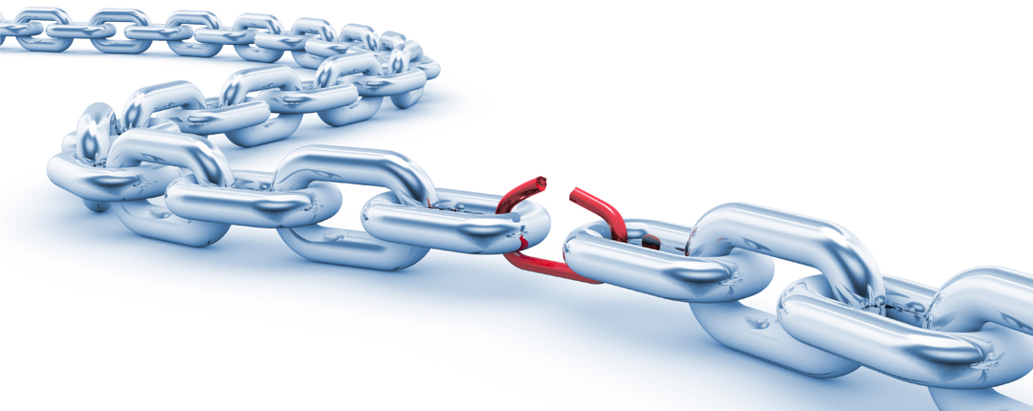
Types of Security Vulnerabilities
Technological
Configuration
Security policy

Slide 21
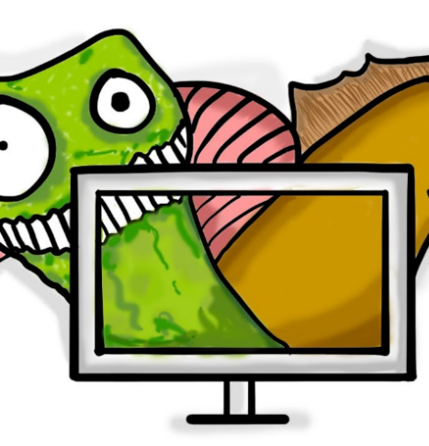
Malware
Virus
Malicious software that is attached to another program to execute a particular unwanted function on a workstation.
Trojan horse
An entire application written to look like something else, when in fact it is an attack tool.

Slide 22

Malware cont.
Worms
Worms are self-contained programs that attack a system and try to exploit a specific vulnerability in the target.
The worm copies its program from the attacking host to the newly exploited system to begin the cycle again.

Slide 23
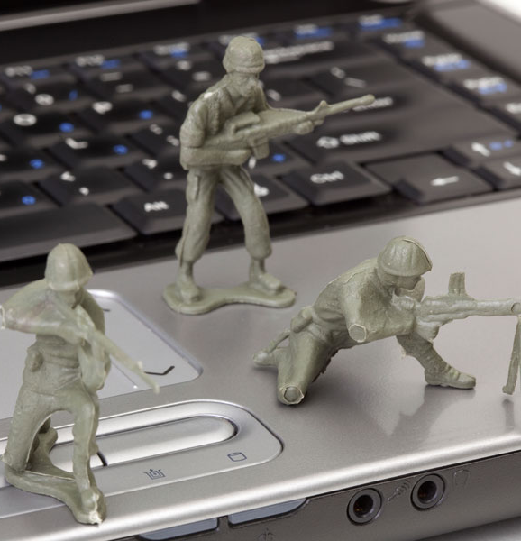
Network Attacks
Malware is a means to get a payload delivered.
When it is delivered and installed, the payload can be used to cause a variety of network related attacks.
Categories of network attacks:
Reconnaissance Attacks
Access Attacks
Social Engineering Attacks
DoS Attacks
Notes:
1.1.2.5 Cloud and Virtual Networks
1.1.2.6 The Evolving Network Border
1.1.2.7 Activity - Network Topology Protection Overview

Slide 24

Reconnaissance Attacks
Known as information gathering.
Analogous to a thief surveying a neighborhood by going door-to-door pretending to sell something.
Eg:
Perform an information query of a target
Initiate a port scan of active IP addresses
Run Vulnerability Scanners
Notes:
1.1.2.5 Cloud and Virtual Networks
1.1.2.6 The Evolving Network Border
1.1.2.7 Activity - Network Topology Protection Overview

Slide 25

Access Attacks
Password Attacks
Brute-force attack
Dictionary attack

Slide 26
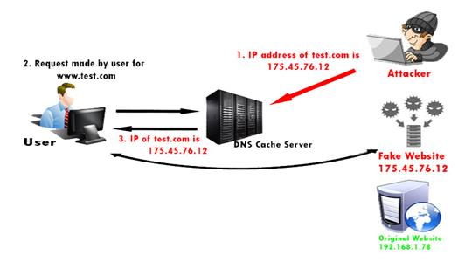

Port Re-direction
Access Attacks cont.

Slide 27
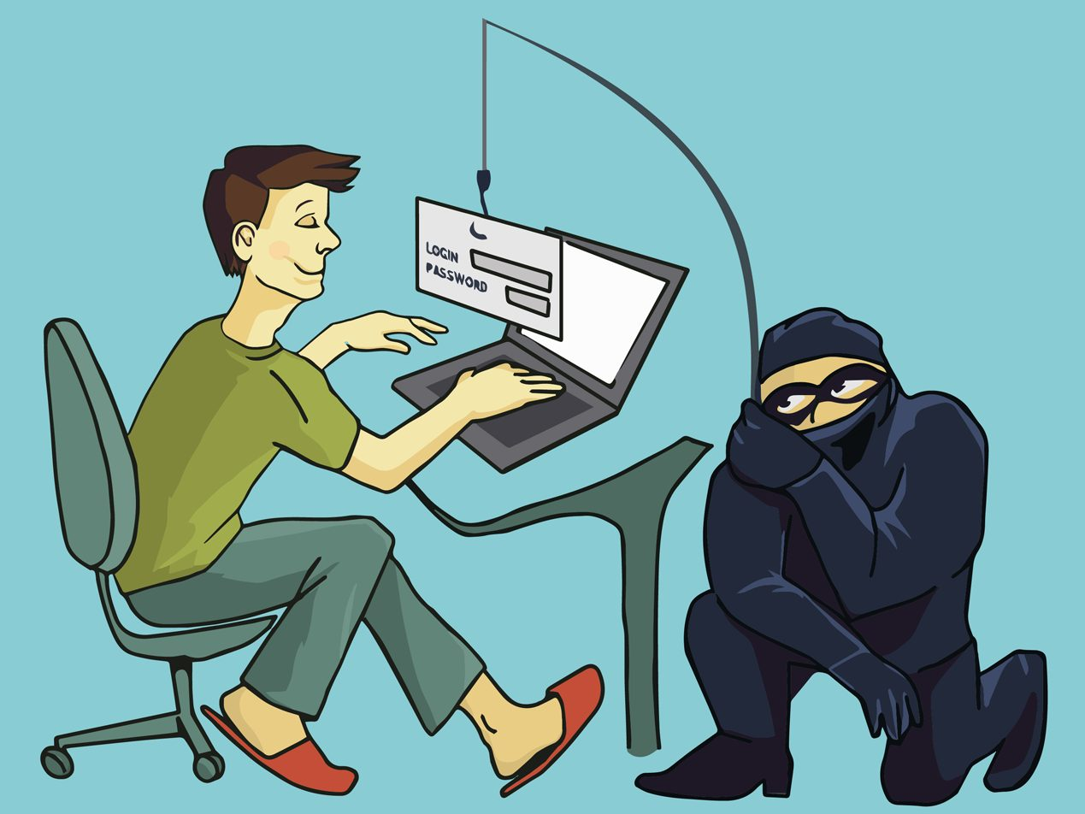

Social Engineering
Attempts to manipulate individuals into performing actions or divulging confidential information.
Notes:
1.1.2.5 Cloud and Virtual Networks
1.1.2.6 The Evolving Network Border
1.1.2.7 Activity - Network Topology Protection Overview

Slide 28
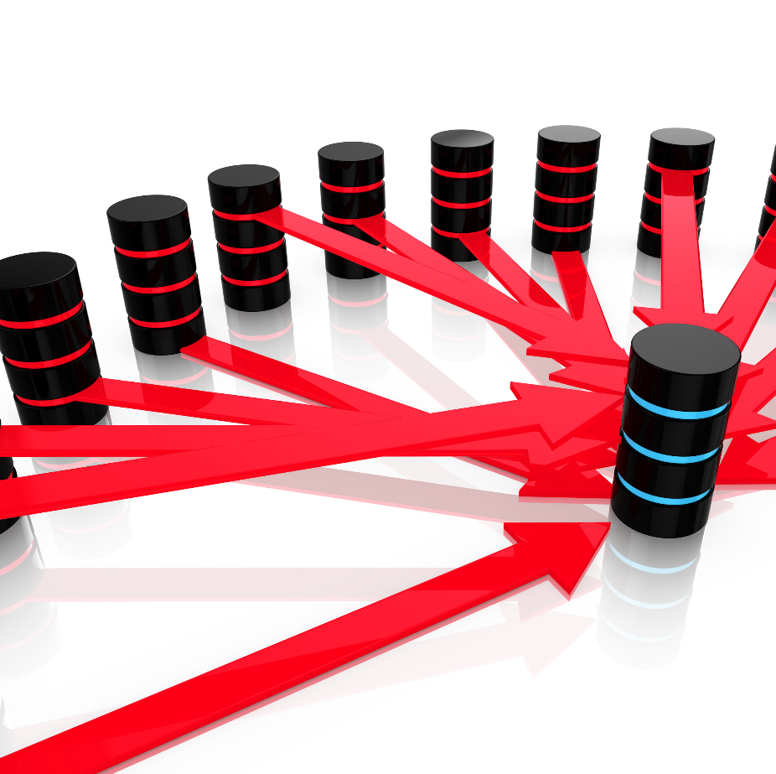
Denial of Service Attacks (DoS)
Attacker floods servers, systems or networks with traffic in order to overwhelm the victim resources and make it difficult or impossible for legitimate users to use them.

Slide 29
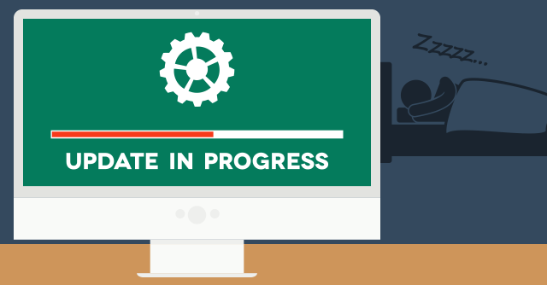
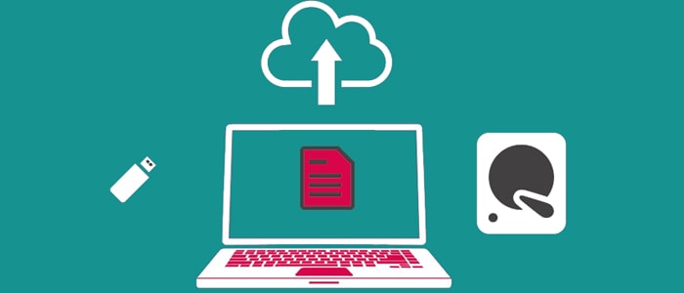
Mitigating Network Attacks
Backup, Upgrade, Update, and Patch
Antivirus software can detect most viruses and many Trojan horse applications and prevent them from spreading in the network.
Keep current with the latest versions of antivirus software.
Install updated security patches.

Slide 30
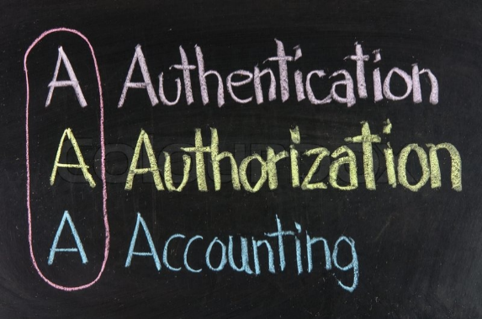
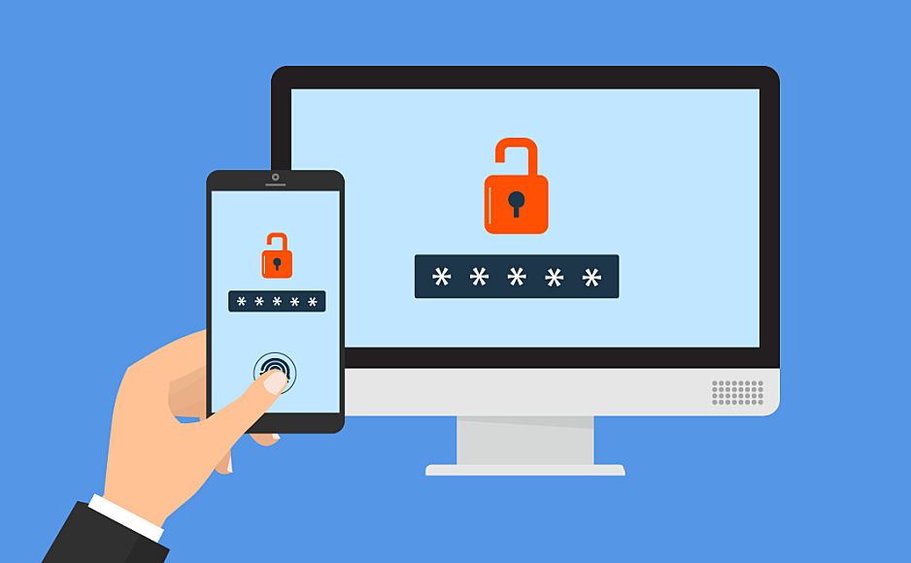
Mitigating Network Attacks
Authentication, Authorization, and Accounting (AAA)
Authentication
Users and administrators must prove their identity.
Username and password combinations
Challenge and response questions
Token cards

Slide 31
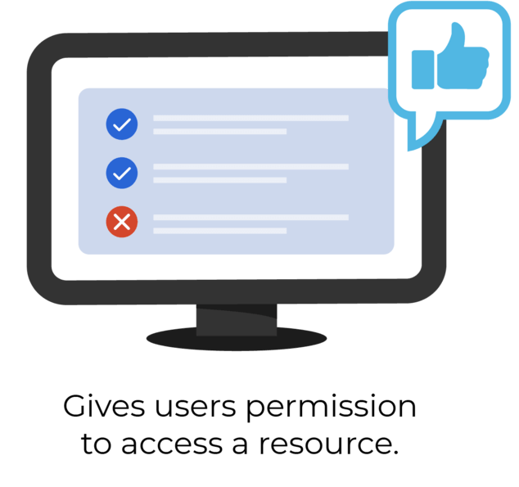
Mitigating Network Attacks
Authentication, Authorization, and Accounting (AAA)
Authorization
Determines which resources the user can access and the operations that the user is allowed to perform.

Slide 32
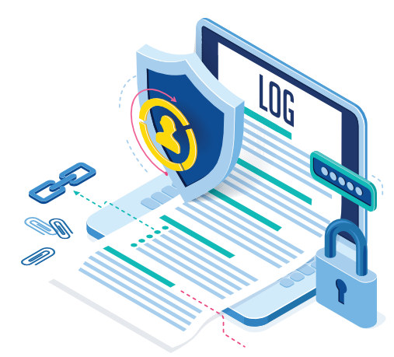
Mitigating Network Attacks
Authentication, Authorization, and Accounting (AAA)
Accounting
Records what the user accessed, the amount of time the resource is accessed, and any changes made.

Slide 33
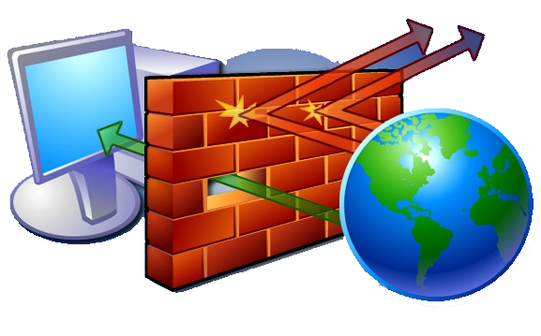
Mitigating Network Attacks
Firewalls
A Firewall resides between two or more networks.
It controls traffic and helps prevent unauthorized access.

Slide 34
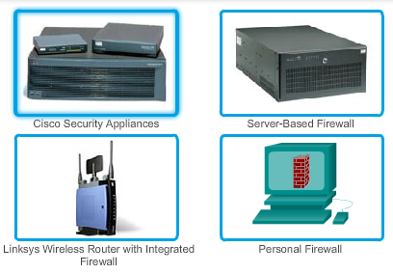
Mitigating Network Attacks
Firewalls Cont.
Methods used are:
Packet Filtering
Application Filtering
URL Filtering
Stateful Packet Inspection (SPI) – Incoming packets must be legitimate responses to requests from internal hosts.

Slide 35
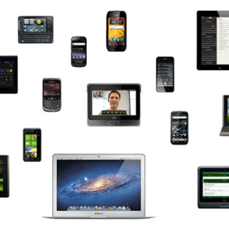
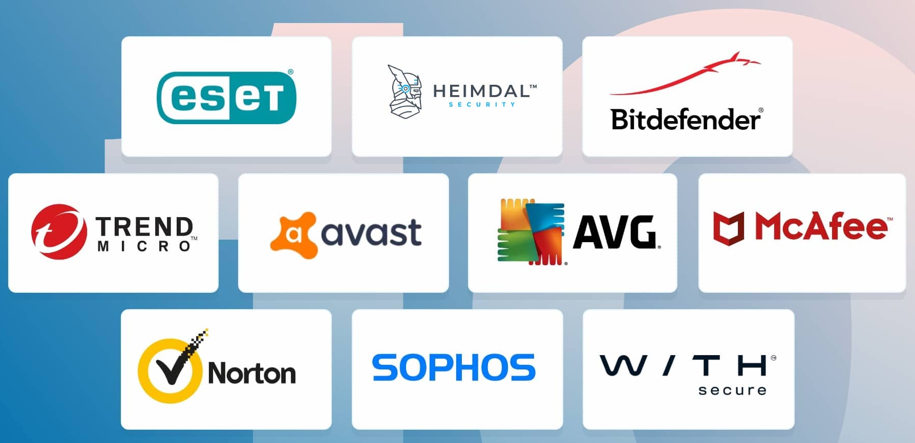
Mitigating Network Attacks cont.
Endpoint Security
Common endpoints: laptops, desktops, servers, smart phones, and tablets.
Employees must follow the companies documented security policies to secure their devices.
Policies include the use of anti-virus software and host intrusion prevention.

Slide 36
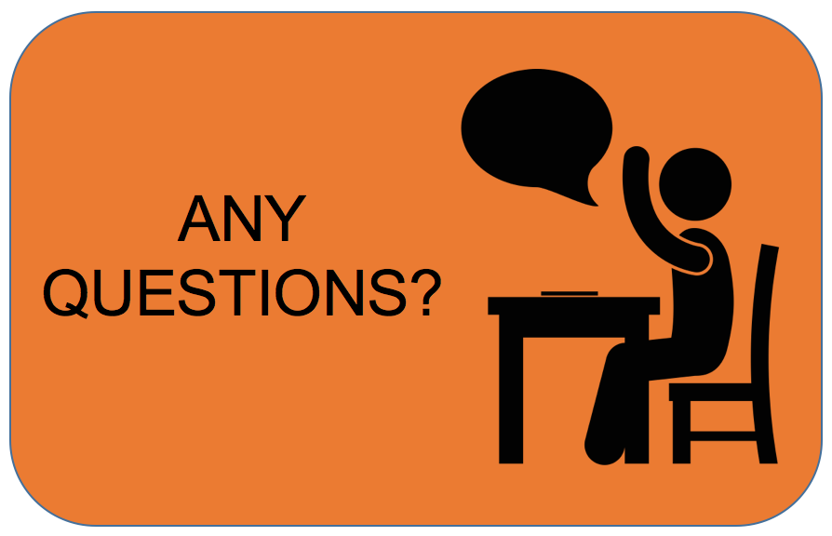
THANK YOU!

